Slide 1
Drugs affecting the endocrine system
ا.م.د. اسامة ايوب
Lec 1

Slide 2
The neuroendocrine system, which is controlled by the pituitary and hypothalamus, coordinates body functions by transmitting messages between individual cells and tissues.
The endocrine system differ from nervous system in communication process

Slide 3
HYPOTHALAMIC AND ANTERIOR PITUITARY HORMONES
all are peptides or low-molecular-weight proteins that act by binding to specific receptor sites on their target tissues
Hormones of the anterior and posterior pituitary are administered either intramuscularly (IM), subcutaneously, or intranasally, but not orally

Slide 4
Adrenocorticotropic hormone (corticotropin)
products of proopiomelanocortin :
Adrenocorticotropic hormone
γ-melanocyte stimulating hormone
β-lipotropin (precursor of the endorphins)
CRH is used diagnostically to differentiate between Cushing syndrome and ectopic ACTH-producing cells.

Slide 5
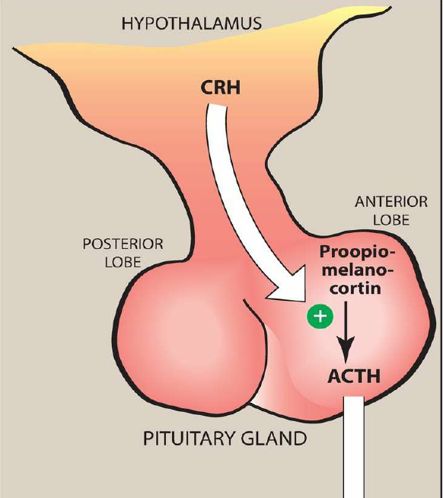

Slide 6
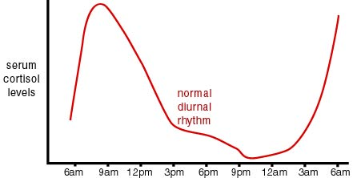
Adrenocorticotropic hormone (corticotropin)
Stress stimulates its secretion, whereas cortisol acting via negative feedback suppresses its release.

Slide 7
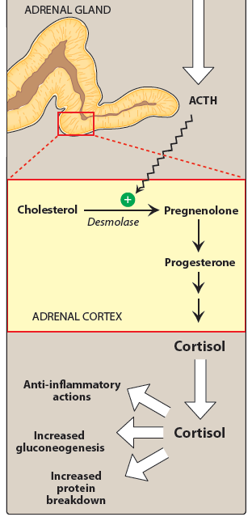
Mechanism of action

Slide 8
Adverse effects:
Short-term use of ACTH for diagnostic purposes is usually well tolerated
similar to those of glucocorticoids, and include
osteoporosis,
hypertension,
peripheral edema,
hypokalemia
emotional disturbances,
and increased risk of infection.

Slide 9
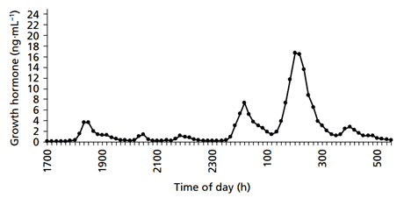
Growth hormone (somatotropin)
Somatostatin inhibit Secretion of GH
GH is released in a pulsatile manner, with the highest levels occurring during sleep.

Slide 10
Growth hormone (somatotropin)
Somatotropin influences a wide variety of biochemical processes:
With increasing age, GH secretion decreases, accompanied by a decrease in lean muscle mass
Synthetic human GH is produced using recombinant DNA technology and is called somatropin.

Slide 11
Mechanism of action
many physiologic effects of GH are exerted directly at its targets
(IGF)-1 released from the liver has an inhibitory effect on growth hormone secretion by stimulating somatostatin release from the hypothalamus.

Slide 12
Growth hormone inhibiting hormone (somatostatin)
somatostatin binds to distinct receptors, SSTR2 and SSTR5, which suppress GH and thyroid-stimulating hormone release.
it is also found in neurons throughout the body as well as in the intestine and pancreas.
inhibits the release of:
GH
Insulin
glucagon, and
gastrin.

Slide 13
Octreotide and lanreotide
are synthetic analogs of somatostatin.
Their half-lives are longer
and depot formulations are available, allowing for administration once every 4 weeks.
Adverse effects
diarrhea, abdominal pain, flatulence, nausea, and steatorrhea. Gallbladder emptying is delayed, and asymptomatic cholesterol gallstones with long-term treatment

Slide 14
An analog of human GH that has polyethylene glycol polymers attached, (pegvisomant), is being employed in the treatment of acromegaly that is refractory to other modes of surgical, radiologic, or pharmacologic intervention.
It acts as an antagonist at one of the GH receptors and results in the normalization of IGF-I levels.

Slide 15
Adverse effects of somatropin
pain at the injection site,
edema,
arthralgias, myalgias,
flu-like symptoms, and
an increased risk of diabetes.
Somatropin should not be used in
pediatric patients with closed epiphyses,
patients with diabetic retinopathy,
obese patients with Prader-Willi syndrome.

Slide 16
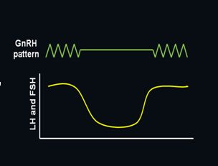
Gonadotropin-releasing hormone/luteinizing hormone releasing hormone
gonadorelin is a decapeptide obtained from the hypothalamus. Pulsatile secretion of GnRH is essential for the release of follicle-stimulating hormone (FSH) and luteinizing hormone (LH) from the pituitary, whereas continuous administration inhibits gonadotropin release.

Slide 17
Gonadotropin-releasing hormone/luteinizing hormone releasing hormone
Leuprolide is also used to suppress the LH surge and prevent premature ovulation in women undergoing controlled ovarian stimulation protocols for the treatment of infertility.
GnRH antagonists such as cetrorelix and ganirelix can also be used to inhibit LH secretion in infertility protocols

Slide 18
Adverse effects
hypersensitivity, dermatitis, and headache
In women, the analogs may cause hot flushes and sweating as well as diminished libido, depression, and ovarian cysts
They are contraindicated in pregnancy and breast-feeding.

Slide 19
Gonadotropins
Chorionic gonadotropin (hCG)(pregnyl is a placental hormone that is excreted in the urine of pregnant women structurally related to LH which is an LH receptor .
Urofollitropin is FSH obtained from postmenopausal women and is devoid of LH.

Slide 20
Follitropin alpha and follitropin beta are human FSH products manufactured using recombinant DNA technology.
Adverse effects include ovarian enlargement and possible ovarian hyperstimulation syndrome, which may be life threatening. Multiple births are not uncommon.

Slide 21
Prolactin
peptide hormone similar in structure to GH, and is also secreted by the anterior pituitary.
The hormone binds to a transmembrane receptor which activates a tyrosine kinase to promote tyrosine phosph-orylation and gene activation

Slide 22
Its secretion is inhibited by dopamine acting at D2 receptors.
Drugs that act as dopamine antagonists (metoclopramide and antipsychotics such as risperidone) can increase the secretion of prolactin.

Slide 23
hyperprolactinemia, which is associated with galactorrhea and hypogonadism, is usually treated with D2-receptor agonists, such as bromocriptine and cabergoline.
Bromocriptine is also indicated for the treatment of type 2 diabetes
Among their adverse effects are nausea, headache, and sometimes, psychiatric problems.

